Slide 1
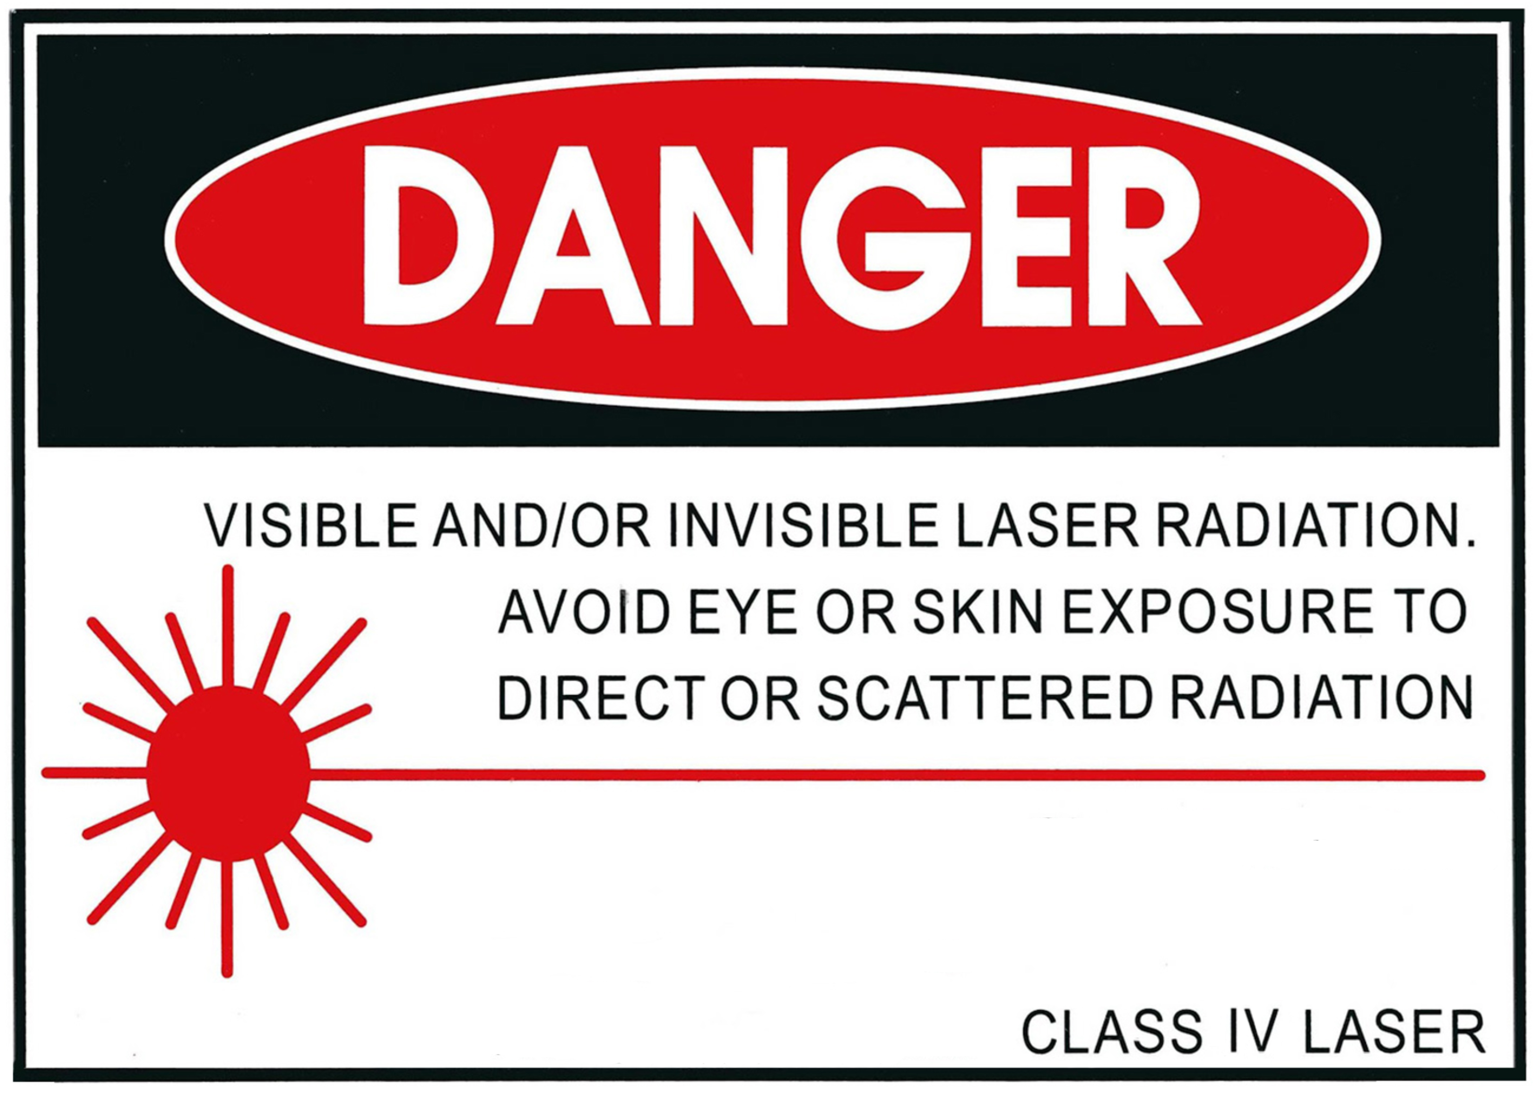
Type/Wavelength:
Pulse Duration/Power:

Slide 2

Type/Wavelength:
Power:

Slide 3
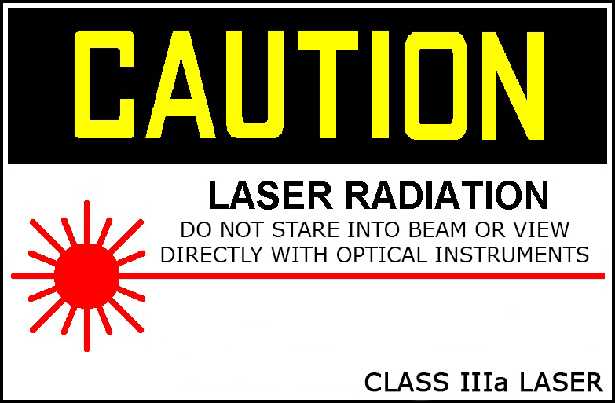
Type/Wavelength:
Power:

Slide 4
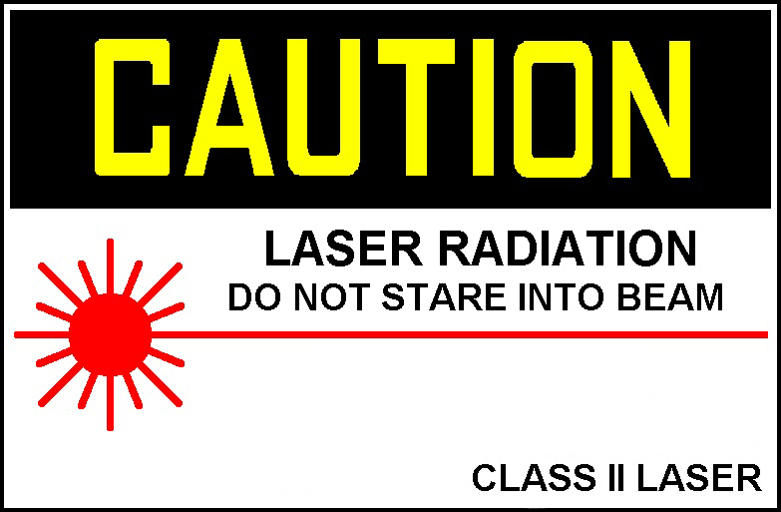
Type/Wavelength:
Power:

